Slide 1
Fuzzy-engine
Etsy Shop Analysis & Sales Prediction
Final Presentation
by Karolina Włoczewska

Slide 2
Dataset & Business Questions
Public Etsy shop-level dataset (2019 snapshot)
Each row = one shop (sales, favourites, reviews, listings, location, marketing flag)
Goal: explore which factors are associated with better shop performance
Main business questions:
  Do location and region matter for sales?
  Do active listings and engagement drive performance?
  Does simple marketing (sale message) help?

Slide 3
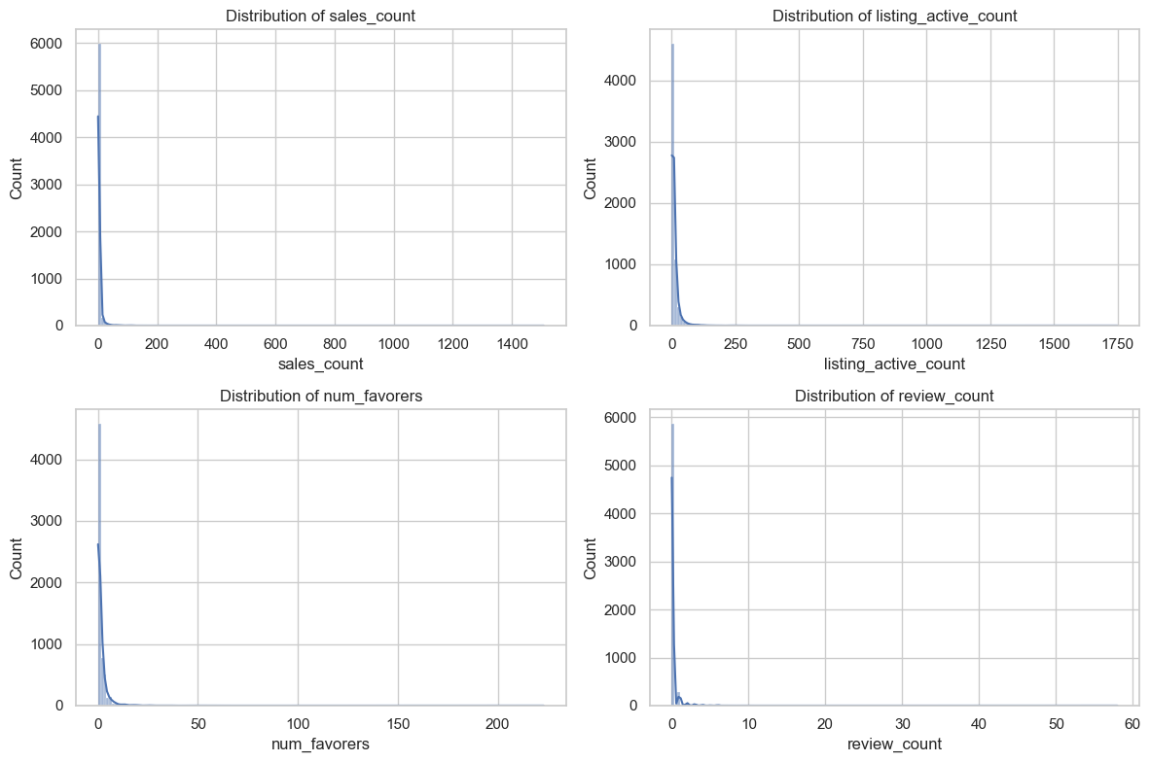
Majority of shops have very low sales

Slide 4
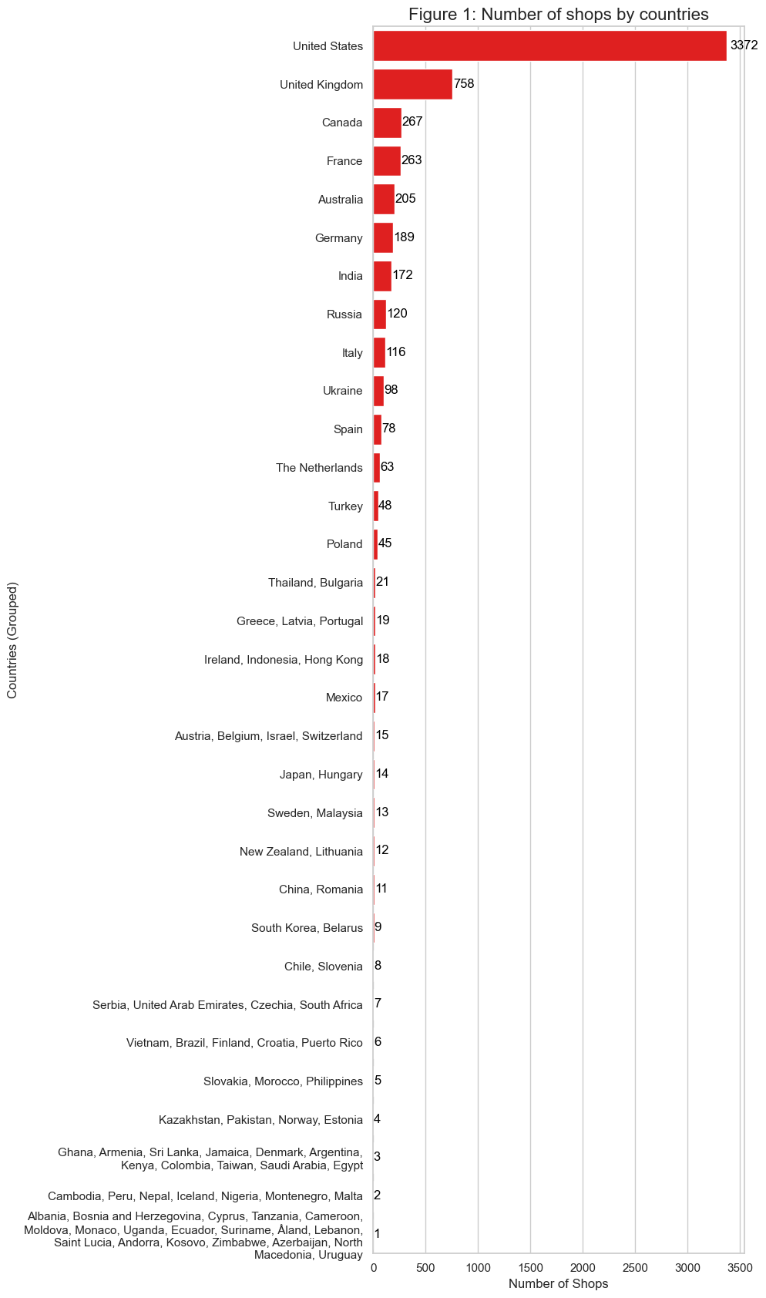
Countries distribution shows a few dominant markets

Slide 5
Hypotheses & Visual Insights

Slide 6
Hypothesis 1 – Country differences
The US and a few European countries have the most shops
Sales variation inside each country is high → country alone is not a strong predictor

Slide 7
More active listings generally correlate with higher sales
Marketing (sale messages) slightly increases median sales
Engagement metrics (favorites, reviews) show weak correlations

Slide 8
EDA – Key Patterns
Sales distribution is extremely skewed:
  many shops have 0–5 sales
  a small number of shops have 200+ sales
USA dominates in number of shops, but performance varies widely within each country
Most shops have a small number of active listings
Engagement variables (favourites, reviews) are also very unevenly distributed

Slide 9
Modeling Results
Linear Regression:
MAE ≈ ~2
Model struggles with high variance in sales
Random Forest:
MAE ≈ ~3
Better but still limited
Large outliers and noisy data reduce performance

Slide 10
Key Challenges
- Heavy skew: most shops have 0–5 sales, few have 100+
- Missing time features (e.g., shop age)
- Unreliable listing/update data
- Sparse engagement signals
- Nonlinear patterns hard to model

Slide 11
Final Conclusions
- Sales are influenced by listings, engagement, and marketing
- However, variability is too large for strong predictions
- Improvements require more complete historical data
- Current model useful only for rough estimation

